Slide 1

Hurricane Evacuation Route Planning
By Jacob Demmons & Rohit Kumar Sah

Slide 2

About Hurricane Evacuation Route Planning
Hurricane evacuation route planning focuses on identifying the safest and fastest paths for people to escape high-risk areas during severe storms. Using real NOAA storm data, hazard zones are mapped to show where storm activity is strongest. Pathfinding algorithms like UCS and A* are then applied to compute optimal evacuation routes that avoid dangerous regions. This approach helps emergency teams make informed decisions, reduce risk, and guide communities safely during hurricane events.

Slide 3
Objective
Develop an intelligent evacuation routing system using real NOAA storm data.
Generate the safest and most efficient evacuation path during hurricanes.
Compare UCS and A* algorithms to identify the best route-planning strategy.

Slide 4
Approach
Collect & preprocess NOAA Storm Events data (lat/long, event types).
Generate hazard maps by converting storm locations into a 100×100 risk grid.
Visualize storm intensity using heatmaps and 3D hazard surfaces.
Implement UCS and A* algorithms to compute evacuation routes.
Compare algorithm performance based on path cost, safety, and runtime.
Select optimal route that minimizes exposure to hazardous zones.

Slide 5
Deliverables
Preprocessed NOAA Storm Dataset
Cleaned and filtered storm event records for analysis.
Hazard Maps & Visualizations
Heatmaps, density plots, and 3D hazard surfaces showing storm intensity.
Pathfinding Algorithms Implementation
UCS and A*–based evacuation route computation.
Evacuation Route Comparison
Metrics table, bar charts, and route overlay visualizations.
Final Project Report & Presentation
Summary of methodology, results, and key insights.

Slide 6

Implementation of Algorithms (UCS & A*)
1. Uniform Cost Search (UCS) Implementation
Expands nodes in order of lowest cumulative cost so far.
Suitable when we don't have a heuristic.
Guarantees optimal path when step costs are positive.
Steps:
Initialize priority queue with the start node.
Repeatedly expand the node with the lowest cost.
Track visited nodes to avoid loops.
Stop when the goal is reached.

Slide 7
2. A* Search Implementation
Uses cost so far + heuristic.
Heuristic: Euclidean distance to the safe zone.
Much faster because the search is guided.
Steps:
Compute:
f(n) = g(n) + h(n)
where
  g(n) = path cost so far
  h(n) = heuristic (distance to goal)
Expand the node with the lowest f(n).
Update neighbors with better cost estimates.
Terminate when goal state is dequeued.

Slide 8
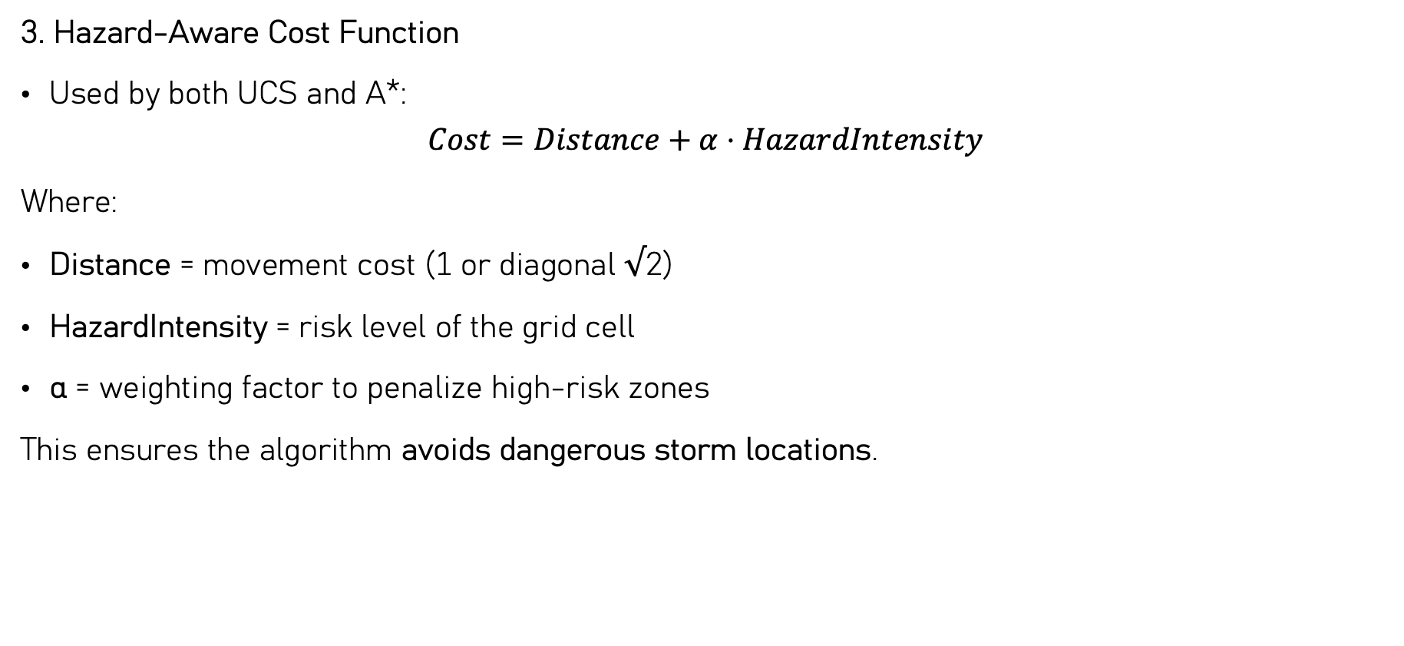
3. Hazard-Aware Cost Function
Used by both UCS and A*:
$$Cost=Distance+α⋅HazardIntensity$$
Where:
Distance = movement cost (1 or diagonal √2)
HazardIntensity = risk level of the grid cell
α = weighting factor to penalize high-risk zones
This ensures the algorithm avoids dangerous storm locations.

Slide 9
4. Output of Implementation
✔ Optimal evacuation path (UCS & A*)
✔ Nodes expanded
✔ Runtime comparison
✔ Visual route plot over storm heatmap
✔ Cost and runtime evaluation table

Slide 10
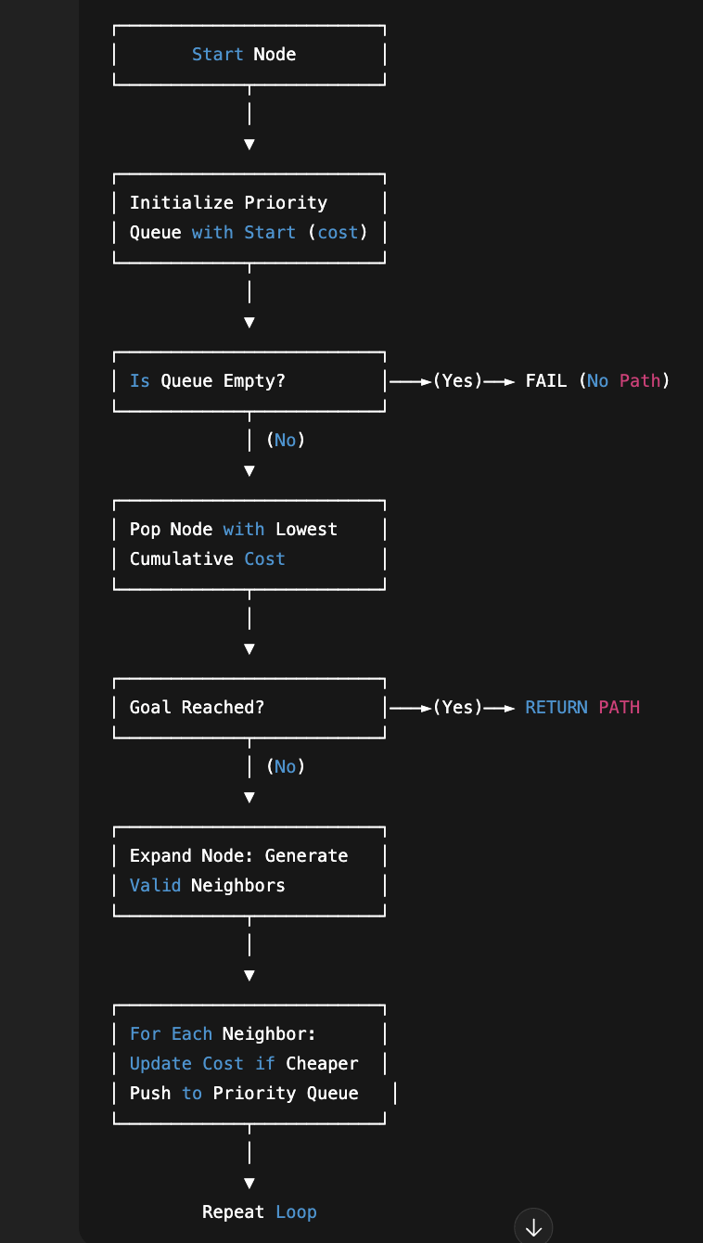
Flowchart:
Uniform Cost Search (UCS)

Slide 11
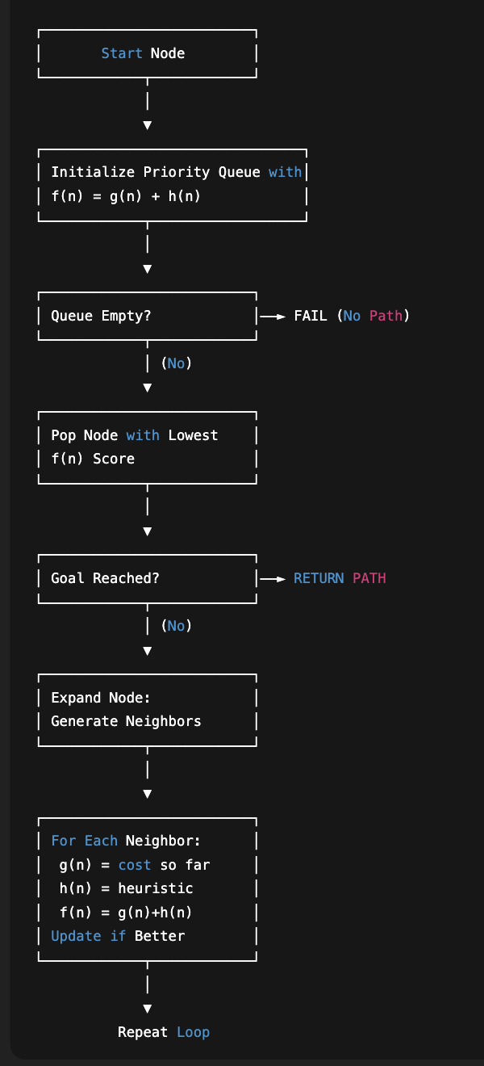
Flowchart:
A* Search Algorithm

Slide 12
Comparison Table
Metric | UCS | A* | Observation
Total Path Cost | 170.53 | 170.53 | Both algorithms find the optimal path.
Path Length (steps) | 171 | 171 | Same number of steps taken.
Nodes Expanded | 171 | 171 | Equivalent exploration due to grid setup.
Runtime (ms) | 75.42 | 52.72 | A* is faster because of the heuristic.

Slide 13
Conclusion
The project successfully demonstrated how search-based AI algorithms can support hurricane evacuation planning.
A* and UCS both produced optimal routes, but A* achieved significantly faster runtime by using a heuristic.
Storm event data and heatmaps helped identify high-risk zones, allowing the agent to avoid hazardous areas.
The final evacuation path balances safety and efficiency, showing how AI can improve real-world disaster response.
This framework can be extended to real geographic data, dynamic storm updates, and multiple evacuation centers.

